Slide 1
Your title
Date of session – Name facilitator/organisation

Slide 2
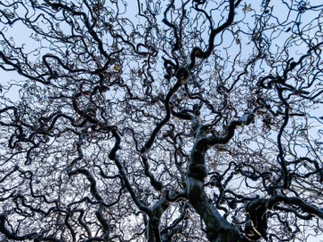
Online Fields – how does it work?
Notes for the Constellator
Thank you for downloading and using the Online Fields template. You as a facilitator will work together with your client and representatives in one document while communicating through a tool like Zoom, Teams, Skype or a phone line. Each participant will move and change a representing symbol depending on its role.
We assume you know how to facilitate a 1:1 or group constellation in person. The Online Fields methods provide the tools and instructions so you can apply your own systemic knowledge and facilitation skills while your client and representatives are remote.
What we learned, our starting point
Systemic awareness is available remote
Representative perception is available remote
You can see the network of relationship(s)
Things which are missing will show up
Basic grammar as direction and distance apply
It works with both 1:1 or a group of representatives
Additions to the grammar are shape, size, color
Important shifts, movements or steps can be easily captured
It might look daunting, but it is a lot of fun to do
OnlineFields.net
This method is offered as an open source under Creative Commons licence - Attribution ShareAlike.
You can use this method as a building block (like a piece of Lego) for your own systemic work, constellations and exercises as long as you credit OnlineFields.net - Jeroen Hermkens, Noemi Viedma.
Looking for more inspiration? Or do you have suggestions? Take a look at OnlineFields.net
v1.01 April 29, 2020

Slide 3
Online Constellation
Date, Time
Welcome & introduction
Check in - what do you need to say to be present
Mechanics of the Online Constellation
Online Constellation - who has a question?
Debrief
Closing

Slide 4
Arrange your video & constellation screen
next to each other
X
X
X
Question
A
X
Question
A
B
A
B
A
B
A
C
B
C
C
C
X
✓
Your video and constellation window should not overlap.
Don’t have them full screen.
Order both windows next to each other.
Make sure that none of your windows is full screen.
Notes:
Note to facilitator:
Take your time for this moment
If your participants have set both windows next to each other the constellation will be far more effective
Make sure the screens are not full screen
Have them resize the windows so they can be next to each other

Slide 5
Copy (CTRL+C) an element representing you

Slide 6
Paste (CTRL+V) your element
add your name (double click)
move, scale, rotate it
hold shift while scaling to keep its ratio

Slide 7
Order your element (CTRL+V) by age
Youngest
Oldest

Slide 8
Where are you geographically located
Location facilitation

Slide 9
Where are you innerly located to this subject?
Peace

Slide 11
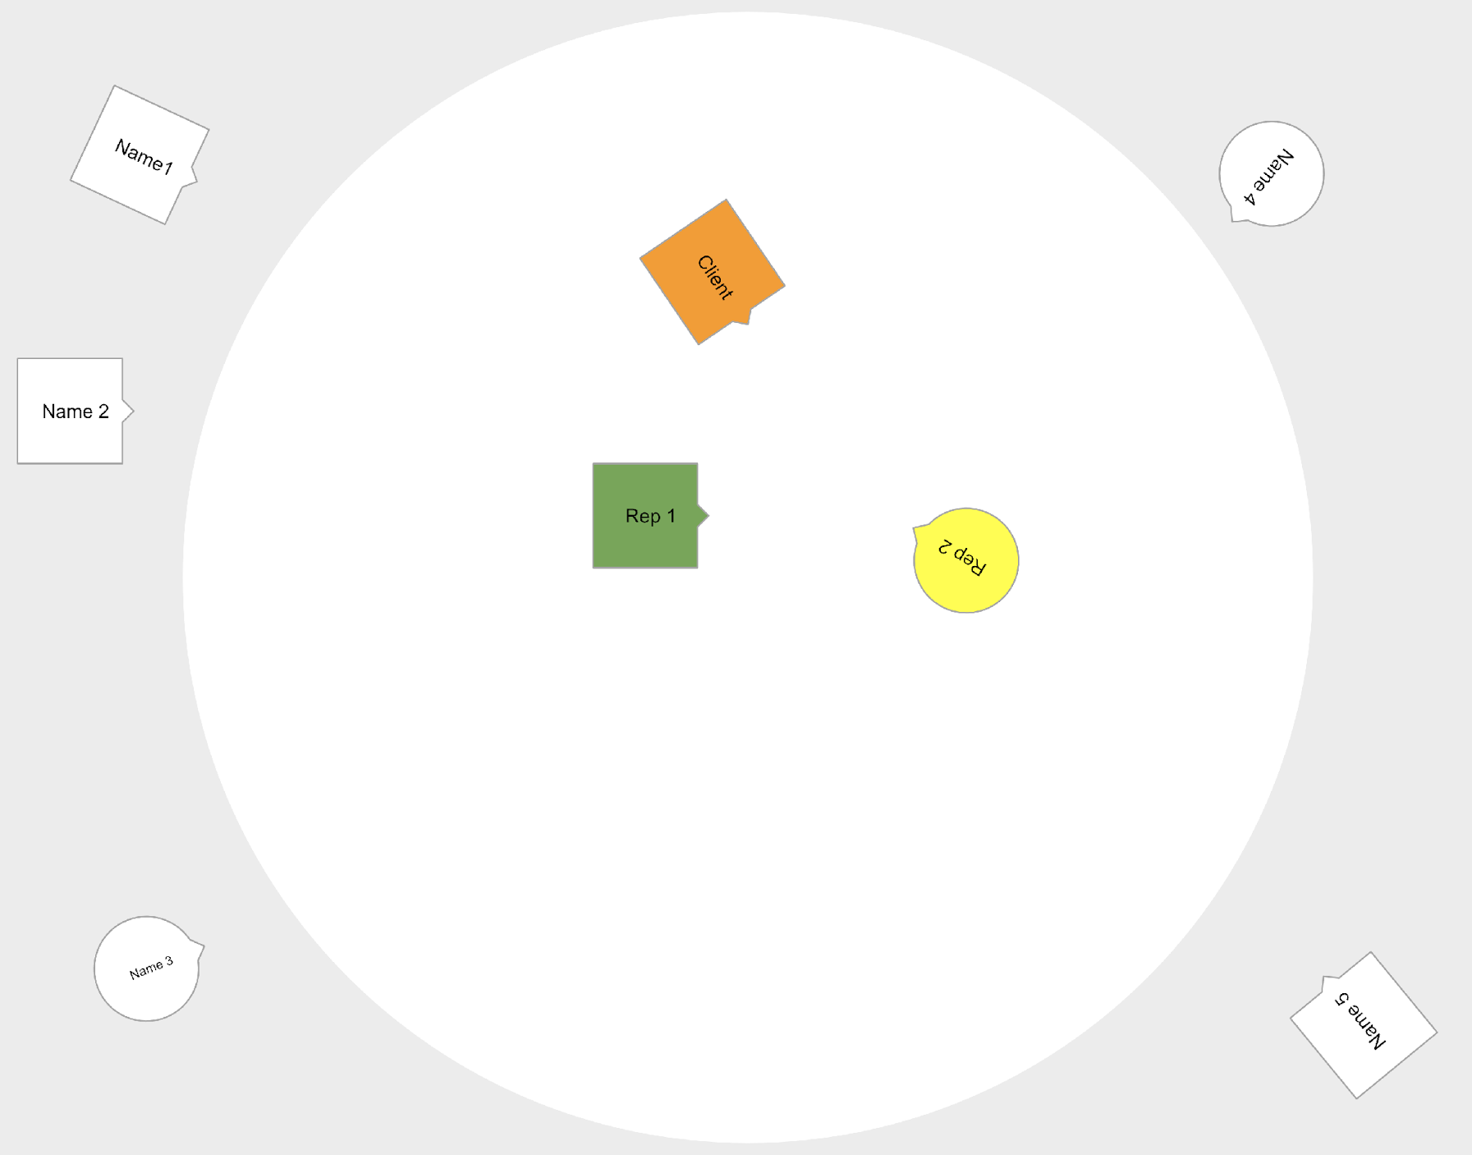
How we will work
Everything is confidential
Your avatar
Choose avatar and add your name
Place your avatar outside of the circle
You are free to move your avatar outside of the circle
If you are called upon
unmute
color your avatar corresponding with what you are representing
Anything to report?
make yourself known to the facilitator (raise hand, wave, speak out)
Slow down, there will be a lot to experience

Slide 12
So who has a question?

Slide 13
Copy (CTRL+C) an element representing you
Je naam

